Slide 1
Fuel Efficiency Analysis
Jeffrey Zhu

Slide 2
Study Parameters
Objective: Identify key attributes that affect vehicle fuel efficiency as measured by annual fuel cost and combined MPG.
Method: Perform a-a tests to first validate normalcy of sample. Then perform independent t-tests to determine statistically significant differences between target groups.
Source Data: https://www.kaggle.com/epa/fuel-economy/version/1
Assumption: Average lifespan of car is 12 years according to TrueCar

Slide 3
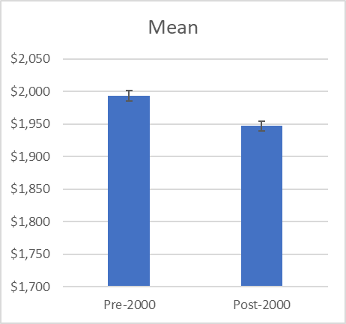
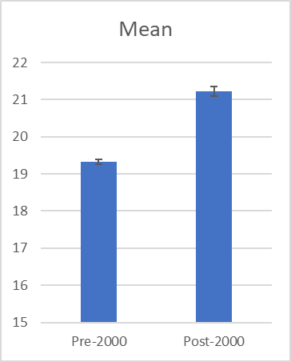
Pre-2000 vs. Post-2000
Pre-2000 mean: $1993, 19.3 mpg
Post-2000 mean: $1947, 21.2 mpg
95% confidence interval difference ($35.4, $57.1), (-2.0mpg, -1.8mpg)
There is a significant difference though not as much as initially expected. Much higher variance in post-2000 car MPG signifying that certain automakers prioritize certain features though the technology to extend MPG is definitely present.

Slide 4
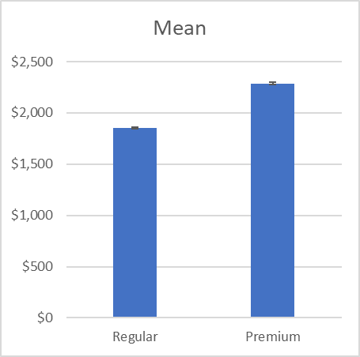
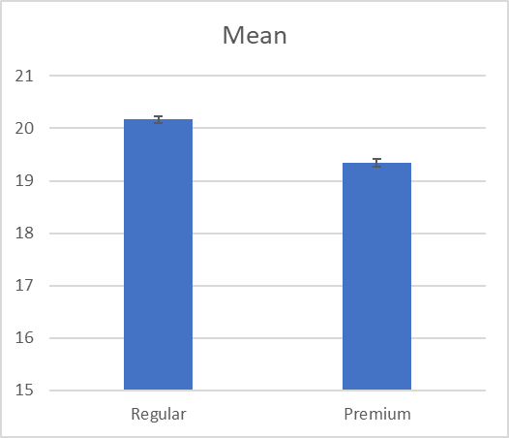
Regular vs. Premium
Regular mean: $1852, 20.2 mpg
Premium mean: $2287, 19.3 mpg
95% confidence interval difference ($-447, $-423), (0.7mpg, 0.9mpg)
Significant difference especially in terms of annual fuel cost (over $5000 for life of car). Mileage not drastically different though statistically significant.
Consider engine maintenance when looking at costs.

Slide 5
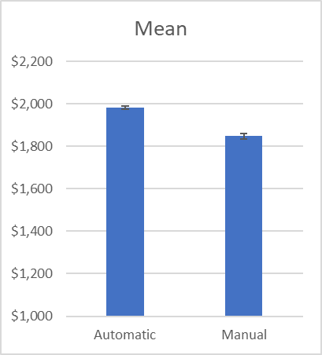
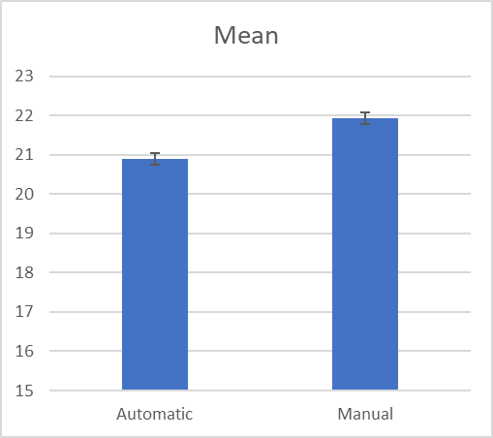
Automatic vs. Manual
Automatic: $1982, 20.9 mpg
Manual: $1847, 21.9 mpg
95% confidence interval difference ($118, $152), (-1.2mpg, -0.8mpg)
Surprising result as manual is colloquially deemed inferior. May be due to engine workload for automatic transmission. Automatic cars also demonstrate a higher variance so confounding variables may affect mpg.

Slide 6
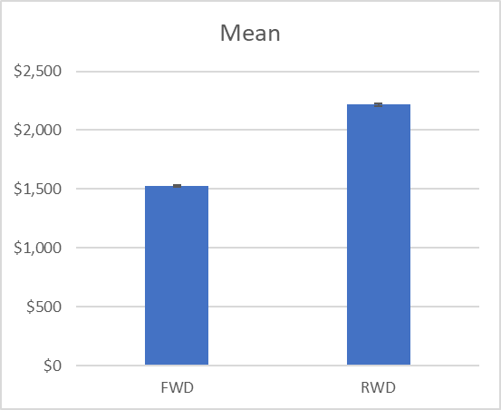
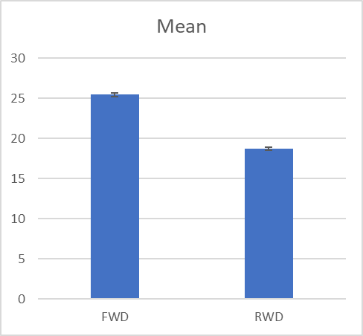
Front-Wheel Drive vs. Rear-Wheel Drive
FWD mean: $1528, 25.5 mpg
RWD mean: $2218, 18.7 mpg
95% confidence interval difference ($-704, $-676), (6.5mpg, 7.1mpg)
Biggest difference in findings and suggest the lightweight system drastically affects fuel economy. Difference ~ $8400 over life of car.
Consumers must seriously consider how much they value driving performance

Slide 7
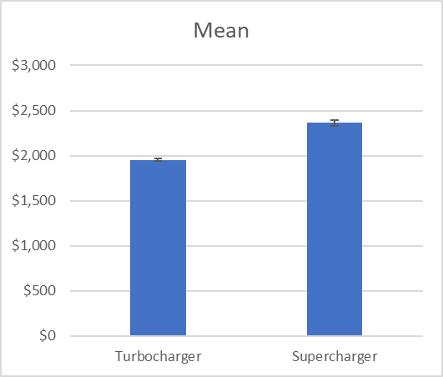
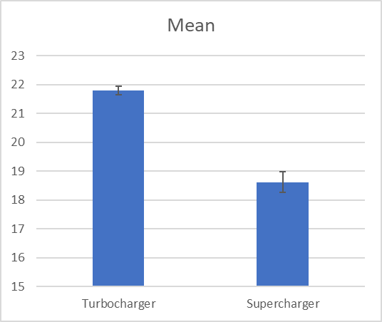
Turbocharger vs. Supercharger
Turbocharger mean: $1954, 21.8 mpg
Supercharger mean: $2362, 18.6 mpg
95% confidence interval difference ($-445, $-371), (2.8mpg, 3.6mpg)
Statistically significant difference totaling ~ $5000 over life of car. Turbocharger may be a good balance for performance and fuel efficiency for consumers looking for faster cars.

Slide 8
Summary and Final Recommendations
Analysis sought to quantify differences between certain characteristics that may be more “optional” when purchasing trim options.
AB testing is best done ceteris paribus though this is not exactly the case with our analysis which is why scope is broader.
Front wheel drive, regular gasoline, and turbocharger vehicles offer the most savings in terms of fuel economy.

